Slide 1


COMP90049 Knowledge Technologies
KNN and Support Vector Machines (LectureSet7)
Rao Kotagiri
School of Computing and Information Systems
The Melbourne School of Engineering
Some of slides are derived from Prof Vipin Kumar and modified, http://www-users.cs.umn.edu/~kumar/

Slide 2
K- Nearest Neighbour (KNN)
It is a geometric based method.
It is a simple technique and works well in many situations.
There is no learning involved.
Given a training data set with labelled information and test case we find K training data points (records) nearest to the test case.
The test case is labelled with the label of the most frequent label of the K nearest points to the test case.
Notes:
Include the cause

Slide 3
K- Nearest Neighbour (KNN) method
For K =3, the example shows how KNN labels an unknown test case .
Some difficulties with KNN:
What should be the distance function?
How do we efficiently find the K-nearest neighbouring points to the test case?
As the number of dimensions increases all the points seem to be more or less at an equal distance (curse of dimensionality). In this case KNN performs poorly and in fact most machine learning methods can fail!
=
=
= ?? In this case --one can choose the default case of the largest class =
=
Notes:
Find the majority one : black square

Slide 4
K- Nearest Neighbour (KNN) method
Advantages:
Very simple scheme with no learning phase.
Works well for small dimensional data.
New data can be easily added and hence it is a Lazy Method.
No need to estimate any probabilities but the notion of K nearest implicitly models the distribution when determining the K-nearest points
=
=
= ?? In this case --one can choose the default case of the largest class =
=
Notes:
KNN doesn’t fit when dimension is very very large
The distance between any two points will be equal.
For example, salary and age, salary will be very large, will be likely equal.

Slide 5
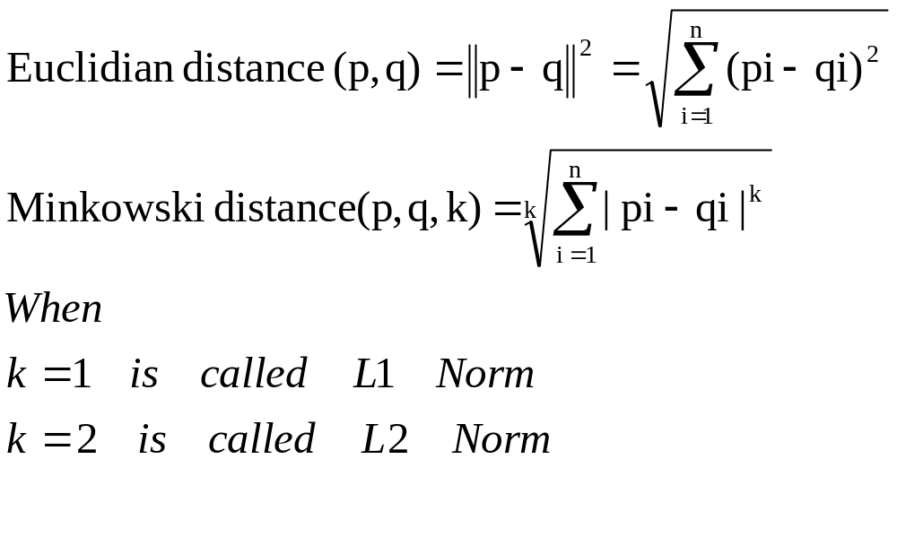

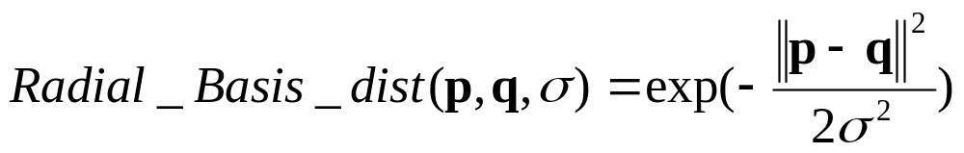
K- Nearest Neighbour (KNN) method
Some difficulties with KNN:
What should be the distance function? Let p = <p1,p2,…,pn> and q = <q1,q2,…,qn> two points in an n-dimensional space.
Notes:
L1 norm, best feature model
L2 norm
Large dimention more caculation

Slide 6
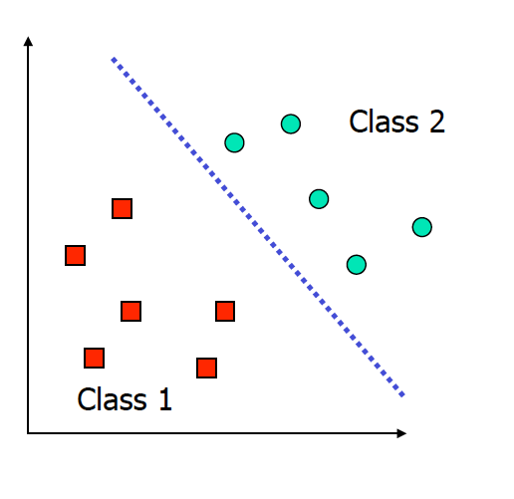
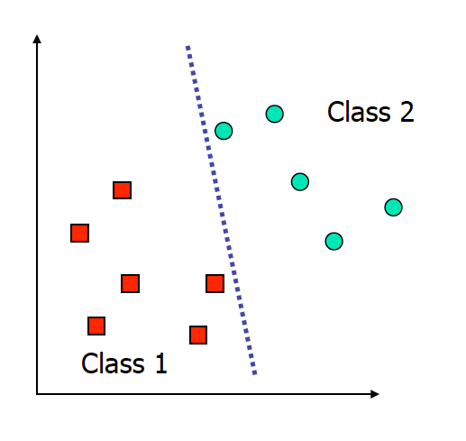
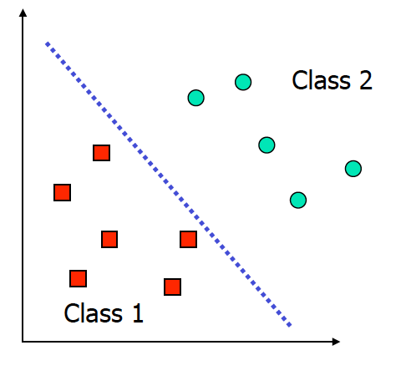
Support Vector Machines (SVM)
We can separate a linearly separable two-class using many decision boundaries. However, some decision boundaries are far better than the others. The goal of SVM is to find the optimal decision boundary.
Examples of a good Decision Boundary
Examples of Bad Decision Boundaries
Notes:
找更好的边界
Small errors will not misclassify

Slide 7
Support Vector Machines
Support vector machines is like Naïve Bayesian Classifier is a statistical machine learning Technique and it is also a geometric based method like KNN (K-nearest neighbour )
Dimension 1
The goal is to find the hyper-planes that maximize the distance between the hyper-planes that separates two classes. The data points on the hyper-plane are called support vectors
Dimension 2
Notes:
Maximize the distance,
More than 3 dimension : hyperplane

Slide 8
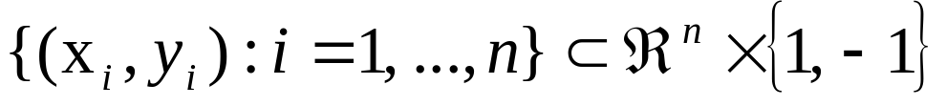
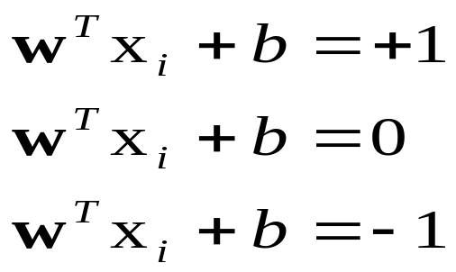
Support Vector Machines
Training Data
i | X |  |  |  | Y
1 | X₁₁ | X₁₂ | … | X_{1m} | +1
2 | X₂₁ | X₂₂ | … | X_{2m} | - 1
…
n | X_{n1} | X_{n2} |  | X_{nm} | -1
X_{i} =<X_{i1},X_{i2},…,X_{im}> these are the feature values of data instance i
Y_{i} = label of instance i. X_{ik} is real number.
The training set can be represented as
The hyper-planes can be represented as
Dimension 1
Dimension 2
Notes:
Goal is to find w and b
To find the hyperplane,

Slide 9
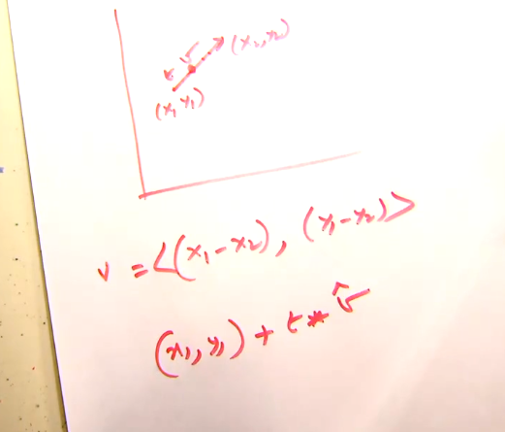
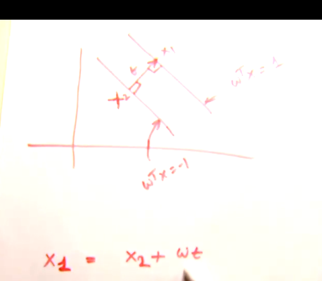
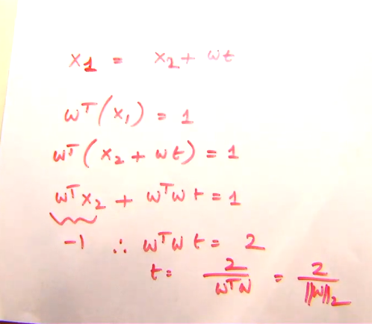
Support Vector Machines
Training Data
i | X |  |  |  | Y
1 | X₁₁ | X₁₂ | … | X_{1m} | +1
2 | X₂₁ | X₂₂ | … | X_{2m} | - 1
…
n | X_{n1} | X_{n2} |  | X_{nm} | -1
X_{i} =<X_{i1},X_{i2},…,X_{im}> these are the feature values of data instance i
Y_{i} = label of instance i. X_{ik} is real number.
The training set can be represented as
The hyper-plane can be represented as
Dimension 1
Dimension 2
2/||W||
Notes:
W is perpendicular to hyperplane
W vector,
Picture shows how to get 2/w

Slide 10
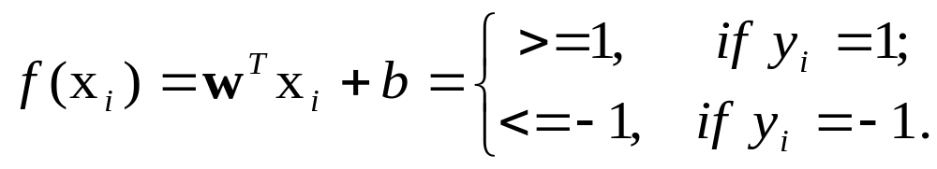
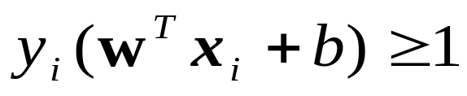
Separating Hyper-plane
For dataset {x_{i}}:

Slide 11
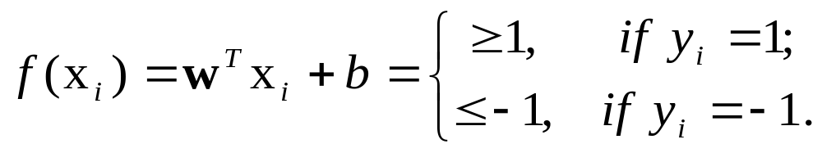
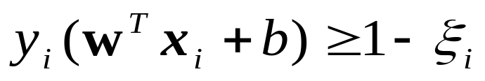
Separating Hyper-plane
For dataset {x_{i}}:
Unfortunately we may not find hyper-panes that can separate given set of training instances. Therefore we allow some margin of errors
Dimension 1
2/||W||
Dimension 2
Notes:
Error would be large
Find the value s should be minimize

Slide 12
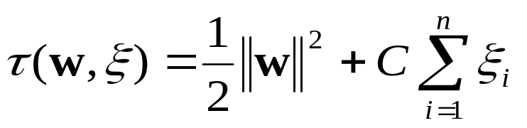
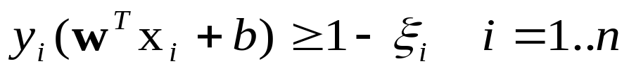
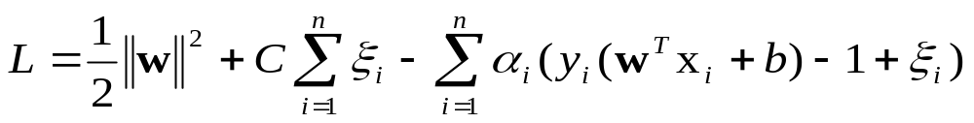
Lagrange function
The optimal hyper-plane is found as the solution to the optimization problem:
minimize
subject to
Lagrangian function:
Dimension 1
2/||W||
Dimension 2
Notes:
Unknow: w C Si

Slide 13
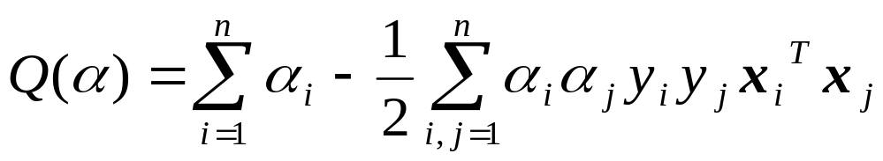
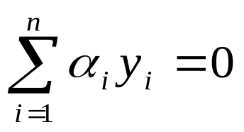
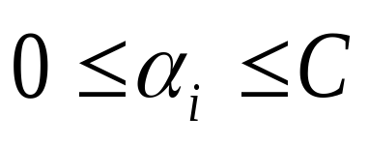

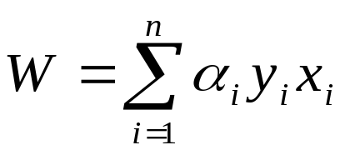
Lagrangian function
For data in the input space:
maximize
subject to
Once optimal are determined, w can be computed as

Slide 14
Kernel mapping
x | y
-3 | c1
-2 | c1
-1 | c2
0 | c2
+1 | c2
+2 | c1
+3 | c1
Class2
Class1
Class1
-3 -2 -1 0 1 2 3
We cannot separate the points by drawing a boundary.

Slide 15
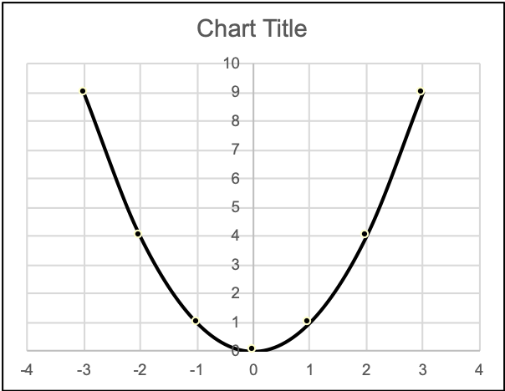
Kernel mapping
x | y
-3 | c1
-2 | c1
-1 | c2
0 | c2
+1 | c2
+2 | c1
+3 | c1
x | x² | y
-3 | 9 | c1
-2 | 4 | c1
-1 | 1 | c2
0 | 0 | c2
+1 | 1 | c2
+2 | 4 | c1
+3 | 9 | c1
𝞍
Class1
Class2

Slide 16
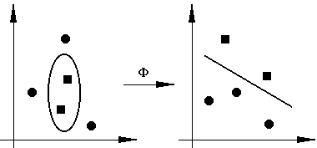
Kernel mapping
K( x_{i}, x_{j} ) = Φ(x_{i})．Φ(x_{j})

Slide 17
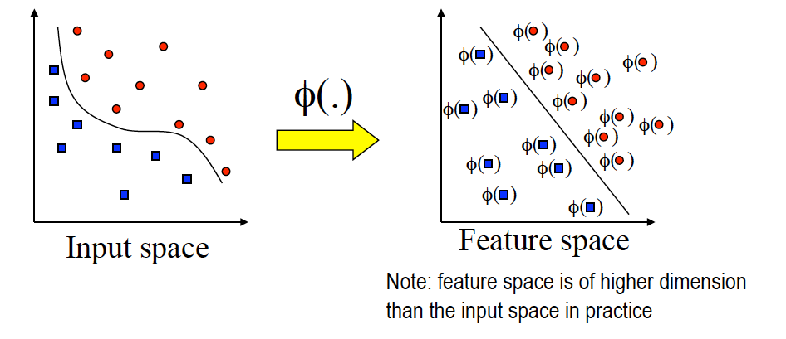
Kernel mapping
K( x_{i}, x_{j} ) = Φ(x_{i})．Φ(x_{j})
Notes:
Don’t call x and y

Slide 18
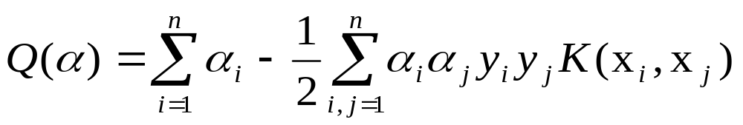
Non-linear case
For data in the input space:
minimize
subject to
where K is a kernel function, by which SVMs may construct a better optimal separating hyper-plane into a higher dimensional feature space.
K( x_{i}, x_{j} ) = Φ(x_{i})．Φ(x_{j})

Slide 19
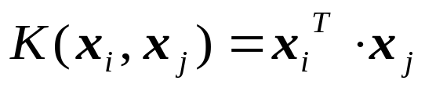
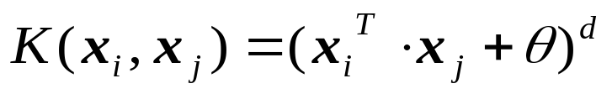
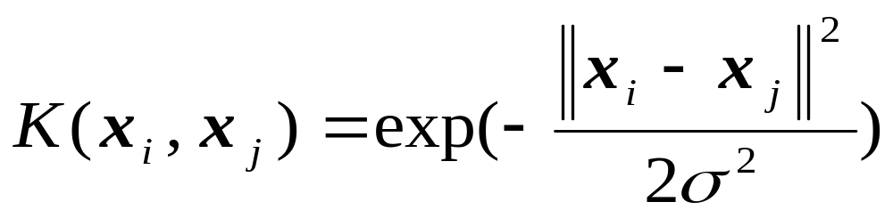
Kernel functions
Linear kernel:
Polynomial kernel:
Radial-basis function (RBF) kernel:
Notes:
If K == 1, very similar

Slide 20
Weaknesses of SVMs
SVM1 C1 vs C2C3 | SVM2 C2 vs C1C3 | SVM3 C3 vs C1C2 | Final Class
C1 | C2 | c3 | Largest-class-of (C1,C2,C3)
C1 | C2 | C1 or C2 | Largest-class-of (C1,C2)
C1 | C1 or C3 | c3 | Largest-class-of (C1,C3)
C1 | C1 or C3 | C1 or C2 | C1
C2 or C3 | C2 | C3 | Largest-class-of (C2,C3)
C2 or C3 | C2 | C1 or C2 | C2
C2 or C3 | C1 or C3 | C3 | C3
C2 or C3 | C1 or C3 | C1 or C3 | Largest-class-of (C1,C2,C3)
  Best performance depends on the choice of the kernel and its parameters.
  Learning is very expensive.
  Generalization to multi-class memberships needs several SVMs
  Some solutions
  Build one versus the rest:
  E.g. 3 class problem c1, c2 and c3
  C1 vs C2 or C3 - SVM1
  C2 vs C1or C3 - SVM2
  C3 vs C1 or C2 - SVM3
  Requires n classifiers
Notes:
Always think SVM
C1 == 1
C2C3 == -1

Slide 21
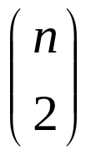
Weaknesses of SVMs
SVM1 C1 vs C2 | SVM2 C1 vs C3 | SVM3 C2 vs C3 | Final Class
C1 | C1 | C2 | C1
C1 | C1 | C3 | C1
C1 | C3 | C2 | Largest-Class-of (C1,C2,C3)
C1 | C3 | C3 | C3
C2 | C1 | C2 | C2
C2 | C1 | C3 | Largest-Class-of C1,C2,C3)
C2 | C3 | C2 | C2
C2 | C3 | C3 | C3
Generalization to multi-class memberships
Some solutions
Build one versus the rest:
One Versus one
E.g. 3 class problem C1,C2 and C3
  C1 vs C2 -SVM1
  C1 vs C3 -SVM2
  C2 vs C3 -SVM
  Requires building classifiers!

Slide 22
Weaknesses of SVMs
Training Data
i | X |  |  |  | Class
1 | X11 | X12 | … | X1m | C3
2 | X21 | X22 | … | X2m | C2
3 | X31 | X32 | … | X3m | C1
…
n | Xn1 | Xn2 |  | Xnm | C4
Generalization to multi-class memberships
  Some solutions
  Build one versus the rest:
  One Versus one
  Build log(n) binary classifiers
  Example assume we have 4 classes
  We build log(4) = 2 classifies
Y1 | Y2 | Class
-1 | -1 | C1
-1 | +1 | C2
+1 | -1 | C3
+1 | +1 | C4

Slide 23
Weaknesses of SVMs
Training Data
i | X |  |  |  | Class
1 | X11 | X12 | … | X1m | C3
2 | X21 | X22 | … | X2m | C2
3 | X31 | X32 | … | X3m | C1
…
n | Xn1 | Xn2 |  | Xnm | C4
Y1 | Y2 | Class
-1 | -1 | C1
-1 | +1 | C2
+1 | -1 | C3
+1 | +1 | C4
Training Data
 | X |  |  |  | Y1 | Y2
1 | X11 | X12 | … | X1m | +1 | -1
2 | X21 | X22 | … | X2m | - 1 | +1
3 | X31 | X32 | … | X3m | - 1 | -1
…
n | Xn1 | Xn2 |  | Xnm | +1 | +1

Slide 24
Weaknesses of SVMs
Training Data
 | X |  |  |  | Y1 | Y2
1 | X11 | X12 | … | X1m | +1 | -1
2 | X21 | X22 | … | X2m | - 1 | +1
3 | X31 | X32 | … | X3m | - 1 | -1
…
n | Xn1 | Xn2 |  | Xnm | +1 | +1
Training Data
i | X |  |  |  | Class
1 | X11 | X12 | … | X1m | C3
2 | X21 | X22 | … | X2m | C2
3 | X31 | X32 | … | X3m | C1
…
n | Xn1 | Xn2 |  | Xnm | C4
Training Data-1
i | X |  |  |  | Y1
1 | X11 | X12 | … | X1m | +1
2 | X21 | X22 | … | X2m | - 1
3 | X31 | X32 | … | X3m | - 1
…
n | Xn1 | Xn2 |  | Xnm | +1
Training Data-2
i | X |  |  |  | Y2
1 | X11 | X12 | … | X1m | -1
2 | X21 | X22 | … | X2m | +1
3 | X31 | X32 | … | X3m | -1
…
n | Xn1 | Xn2 |  | Xnm | +1

